Slide 1

Sentiment Classification and
Analysis of Movie Reviews using NLP Techniques
Team-27
Abdullah Rahat - 20301134
Nusaiba Rahat - 20301136
Abid Al Mamun - 19301066
Md. Ajmain Aosaf Anan - 20101388
Shuvo karmokar - 20301441

Slide 2
Introduction
Deep Learning for Language Understanding:
Deep learning surpasses traditional methods in comprehending language nuances and context.
Successfully applied in various scenarios, deep learning excels in understanding words and analyzing extensive text documents.
Sentiment Analysis in Movie Reviews:
This paper focuses on sentiment analysis to understand human expression in movie reviews.
By analyzing sentiments, valuable insights for filmmakers and advertisers can be gained.
Model Testing and Impact:
Tested on a dataset of 50,000 movie reviews, the models achieve high accuracy, with the Recurrent Neural Network (RNN) reaching 84% accuracy.
The aim is to improve decision-making in movie production by leveraging audience sentiments to better understand preferences and dislikes.

Slide 3
Motivation
We aim to empower filmmakers by providing them with valuable insights into audience sentiments through our sentiment analysis of movie reviews.
Our research strives to enhance decision-making processes in the film industry by offering data-driven insights on audience preferences and reactions to movies.
By understanding and analyzing movie reviews, we endeavor to improve audience engagement and satisfaction, ultimately contributing to the enjoyment of cinematic experiences for all.

Slide 4
Literature Review
Aspect-Based Sentiment Analysis (ABSA):
ABSA is crucial for understanding detailed opinions across different languages and topics.
Stemming and lemmatization, like Debela's stemmers, enhance sentiment analysis accuracy in languages like Afaan Oromoo.
Aspect term extraction (ATE) is essential for identifying specific parts mentioned in reviews, improving analysis precision.
Feature Extraction and Model Performance:
Bag of words and TF-IDF are commonly used for feature extraction, capturing minor sentiment differences.
Inter-Annotator Agreement (IAA) metrics, such as Cohen’s coefficient, ensure reliability of labeled datasets.
Tuning hyperparameters improves model performance, enhancing accuracy and precision.
ConvLSTM for Movie Sentiment Analysis:
Deep learning, particularly ConvLSTM models, shows promise in capturing delicate feelings in movie reviews.
ConvLSTM outperforms traditional methods like SVM and Naive Bayes, as well as LSTM and LSTM with attention layers, in capturing sequential dependencies.
This advancement could revolutionize the film industry by improving market research and recommendation systems, and aiding filmmakers in decision-making.
Limitations and Future Directions:
Despite its potential, ConvLSTM has limitations, such as reliance on IMDb data which may not fully represent diverse audience sentiments.
Further investigation into model comparisons and understanding performance-influencing elements is essential.
Considering demographic changes and real-world circumstances can enhance the study's applicability and impact.

Slide 5
Dataset
In this project, the aim is to perform sentiment analysis on the IMDB movie review dataset.IMDB dataset having 50K movie reviews for natural language processing or Text analytics
This is a dataset for binary sentiment classification containing substantially more data than previous benchmark datasets..
Dataset: Andrew L. Maas, Raymond E. Daly, Peter T. Pham, Dan Huang, Andrew Y. Ng, and Christopher Potts. (2011). Learning Word Vectors for Sentiment Analysis. The 49th Annual Meeting of the Association for Computational Linguistics (ACL 2011

Slide 6
Data Pre-processing
Exploratory Data Analysis (EDA):
Dimensions: Use df.shape.
First Few Rows: Employ df.head().
Statistical Info: Utilize df.describe().
Sentiment Distribution: Check with df['sentiment'].value_counts().
Dataset Balancing :
25,000 negative and 25,000 positive reviews.
Employed an 80:20 split for training and testing.
Preprocessing Steps
HTML Tags Removal: Used BeautifulSoup library.
Elimination of Square Brackets: May contain irrelevant info.
Special Character Removal: Utilized regular expressions.
Text Normalization: Converted all characters to lowercase.
Stemming: Reduced words to root form using Porter Stemmer.
Stopwords Removal: Eliminated common English stopwords.

Slide 7
Methodology
Feature Extraction:
Converts text data into numerical features for ML models.
Tokenization: Splits text into words or tokens.
Vectorization: Converts tokens into numerical vectors (BoW, TF-IDF, Word Embeddings).
Model Selection:
Traditional ML models tested: Logistic Regression (LR), Multinomial Naive Bayes (MNB), Support Vector Machine (SVM).
Best performers: LR and MNB, consistent across BoW and TF-IDF.
SVM showed inferior performance, especially with TF-IDF features.
RNN model experimented for sequence modeling, performance compared to traditional ML models.
Calculated the total number of categories (folders) and images in the dataset. and displayed a few sample images from the dataset and their dimensions.

Slide 8
Methodology (continue)
Model Evaluation:
LR with BoW: Accuracy 75.12%, balanced precision, recall, and F1-scores.
MNB with TF-IDF: Accuracy 75.09%, consistent precision and recall.
SVM with BoW: Accuracy 58.29%, imbalanced performance, particularly with low recall for positive sentiments.
SVM with TF-IDF: Accuracy 51.12%, challenges in classifying positive sentiments.
LR and MNB showcased robust performance, highlighting their suitability for sentiment analysis tasks.

Slide 9
Model Implementation
Traditional Machine Learning Models:
Logistic Regression and Multinomial Naive Bayes: Known for simplicity, efficiency, and interpretability, making them suitable for baseline sentiment analysis tasks.
Support Vector Machine (SVM): Despite its performance issues, SVM is chosen for its ability to handle high-dimensional data well and its effectiveness with linearly separable classes.
Recurrent Neural Network (RNN):
RNN: Chosen for its capability to model sequential data and capture dependencies over time, making it suitable for analyzing text data like movie reviews which have inherent sequential structure.

Slide 10
Feature Representation:
BoW (Bag-of-Words):
BoW represents text data as a collection of words, disregarding grammar and word order.
Each document is represented by a vector where each dimension corresponds to a unique word in the vocabulary, and the value indicates the frequency of the word in the document.
BoW is used in the project for its simplicity and effectiveness in capturing the presence of words in the text data.

Slide 11
Feature Representation (continue)
TF-IDF (Term Frequency-Inverse Document Frequency):
TF-IDF represents text data by considering the importance of words in documents.
It calculates the frequency of a word in a document (TF) and scales it by the frequency of the word across all documents (IDF).
Words that appear frequently in a document but rarely in other documents are given higher importance.
TF-IDF is used in the project to address the issue of common words by downweighting them and emphasizing rare words, potentially improving the model's ability to capture meaningful information.

Slide 12
RNN Architecture
Sequential model architecture implemented for RNN.
Embedding layer for converting text to dense vectors.
SimpleRNN layer for sequence modeling.
Dense layer for binary sentiment classification.
Data Preparation:
Tokenization and padding performed using Keras Tokenizer.
Ensured uniform sequence length for RNN input.
Training and Optimization:
Adam optimizer and binary cross entropy loss used.
Trained over 5 epochs with batch size of 64.
20% validation split for monitoring performance.
Evaluation:
Model's accuracy evaluated on test dataset.
Measures effectiveness in sentiment classification for movie reviews.

Slide 13
Result
Traditional Machine Learning Model:
.Logistic Regression (BoW):
Accuracy: 75.12%
Precision (Positive): 0.75
Precision (Negative): 0.75
Recall (Positive): 0.75
Recall (Negative): 0.75
F1-score (Positive): 0.75
F1-score (Negative): 0.75
Logistic Regression (TF-IDF):
Accuracy: 75.00%
Precision (Positive): 0.74
Precision (Negative): 0.76
Recall (Positive): 0.77
Recall (Negative): 0.73
F1-score (Positive): 0.75
F1-score (Negative): 0.75

Slide 14
Result (continue)
Traditional Machine Learning Model:
.Logistic Regression (BoW):
Accuracy: 75.12%
Precision (Positive): 0.75
Precision (Negative): 0.75
Recall (Positive): 0.75
Recall (Negative): 0.75
F1-score (Positive): 0.75
F1-score (Negative): 0.75
Logistic Regression (TF-IDF):
Accuracy: 75.00%
Precision (Positive): 0.74
Precision (Negative): 0.76
Recall (Positive): 0.77
Recall (Negative): 0.73
F1-score (Positive): 0.75
F1-score (Negative): 0.75

Slide 15
Result (continue)
Traditional Machine Learning Model:
Support Vector Machine (BoW):
Accuracy: 58.29%
Precision (Positive): 0.94
Precision (Negative): 0.55
Recall (Positive): 0.18
Recall (Negative): 0.99
F1-score (Positive): 0.30
F1-score (Negative): 0.70
Support Vector Machine (TF-IDF):
Accuracy: 51.12%
Precision (Positive): 1.00
Precision (Negative): 0.51
Recall (Positive): 0.02
Recall (Negative): 1.00
F1-score (Positive): 0.04
F1-score (Negative): 0.67

Slide 16
Result (continue)
Deep Learning Model:
Recurrent Neural Network:
The RNN model was trained over 5 epochs with the following results:
Epoch 1: Loss: 0.6205, Accuracy: 62.64%, Validation Loss: 0.8979, Validation Accuracy: 61.74%
Epoch 2: Loss: 0.3764, Accuracy: 83.90%, Validation Loss: 1.4732, Validation Accuracy: 56.77%
Epoch 3: Loss: 0.2913, Accuracy: 88.43%, Validation Loss: 0.5619, Validation Accuracy: 81.55%
Epoch 4: Loss: 0.2274, Accuracy: 91.37%, Validation Loss: 0.6866, Validation Accuracy: 79.56%
Epoch 5: Loss: 0.1847, Accuracy: 93.24%, Validation Loss: 0.6123, Validation Accuracy: 83.64%
The final accuracy on the test set was 84.29%

Slide 17
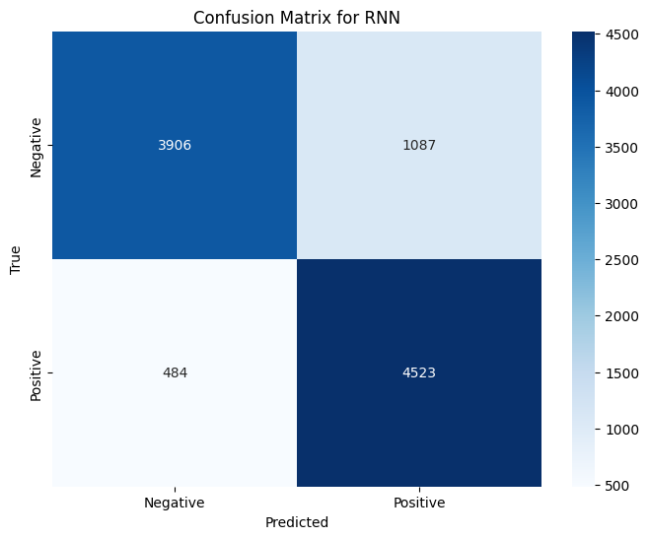
Confusion
Matrix For RNN:

Slide 18
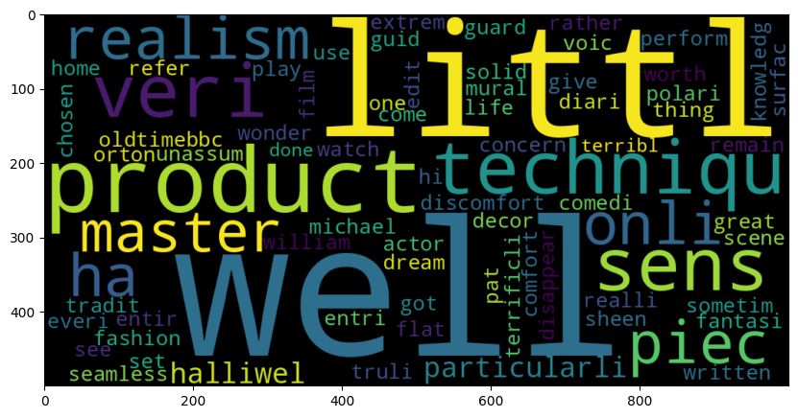
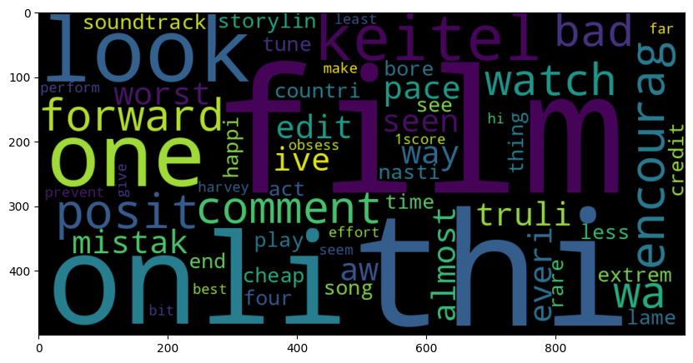
Visual Representation of Sentiment
Word clouds provide a visual representation of the most frequent words in positive and negative movie reviews. Words are sized according to their frequency, highlighting prominent terms in each sentiment category.
Positive Review
Negative Review

Slide 19
Discussion (Key Points)
The best result we get from the RNN model. Since deep Learning models need a lot of data to perform and we could provide our model that much data
SVM was the worst performer while Logistic Regression and Naive Bayes both did well for BoW and TF-IDF
If we could have more data we could use more complex Neural model like LSTM with custom layer and pooling. But for a mini project it was an more than enough accuracy

Slide 20
Limitations
Despite achieving superior results, our study has limitations that warrant consideration.
The reliance on IMDb data may introduce bias, as it may not fully represent diverse audience opinions across various platforms and languages.
Preprocessing procedures, while extensive, may not completely eliminate biases inherent in the dataset, potentially affecting model performance.
Further investigation into model comparisons and performance-influencing elements is essential to enhance the robustness and generalizability of our findings.

Slide 21
Conclusion & Future Work
Our sentiment analysis journey unveils the importance of understanding audience feelings towards movies.
The success of our RNN model, achieving an 84% accuracy, showcases the efficacy of modern technology in decoding emotions from text.
Further refinement of sentiment analysis tools to enhance model accuracy and applicability.
Continued exploration of deep learning techniques to capture nuanced emotions and context in movie reviews.

Slide 22
References
Dey, S., Chakraborty, S., Saha, S., & Chakraborty, A. (2016). Sentiment analysis of movie reviews using machine learning techniques. In 2016 International Conference on Electrical, Electronics, and Optimization Techniques (ICEEOT) (pp. 581-586). IEEE.
El-Din, S. S. A. (2016). Sentiment analysis in movie reviews based on machine learning techniques. In 2016 7th Cairo International Biomedical Engineering Conference (CIBEC) (pp. 106-109). IEEE.
Ahuja, S., Sahu, T. P., & Singh, A. (2019). Sentiment analysis of movie reviews: A study on feature selection & classification algorithm. In 2019 2nd International Conference on Computing, Mathematics and Communication Technologies (ICMCT) (pp. 1-4). IEEE.
Can, A., Koc, A. B., Sen, B., & Kucuktunc, O. (2018). Sentiment classification of Turkish movie reviews using machine learning techniques. In 2018 6th International Istanbul Smart Grids and Cities Congress and Fair (ICSG Istanbul) (pp. 1-5). IEEE.
Can, F., & Sarıyar, M. (2018). Turkish Movie Reviews Sentiment Analysis. Journal of Engineering Research and Applied Science, 5(2), 785-792.
Horsa, O. G., & Tune, K. K. (2023). Aspect-Based sentiment analysis for AFAAN Oromoo movie reviews using machine learning techniques. Applied Computational Intelligence and Soft Computing, 2023, 1–12. https://doi.org/10.1155/2023/3462691
Xu, J. (2024, February). Decoding sentiment: A sentiment analysis model for movie reviews. Applied and Computational Engineering, 37(1), 31-37. https://doi.org/10.54254/2755-2721/37/20230466

